Slide 1

24
7
30
Date
Rates
EQ – What are the different methods for answering rates questions?
How do we find the rate?
To find the rate we need to work out what one of that unit will be.
To do this we need to divide both numbers by the same number

Slide 2
Practice questions (together)
Julie spent $100 in 4 hours.
Steven drove 330km in 6 hours.
Jamie earnt $2555 in a fortnight.

Slide 3
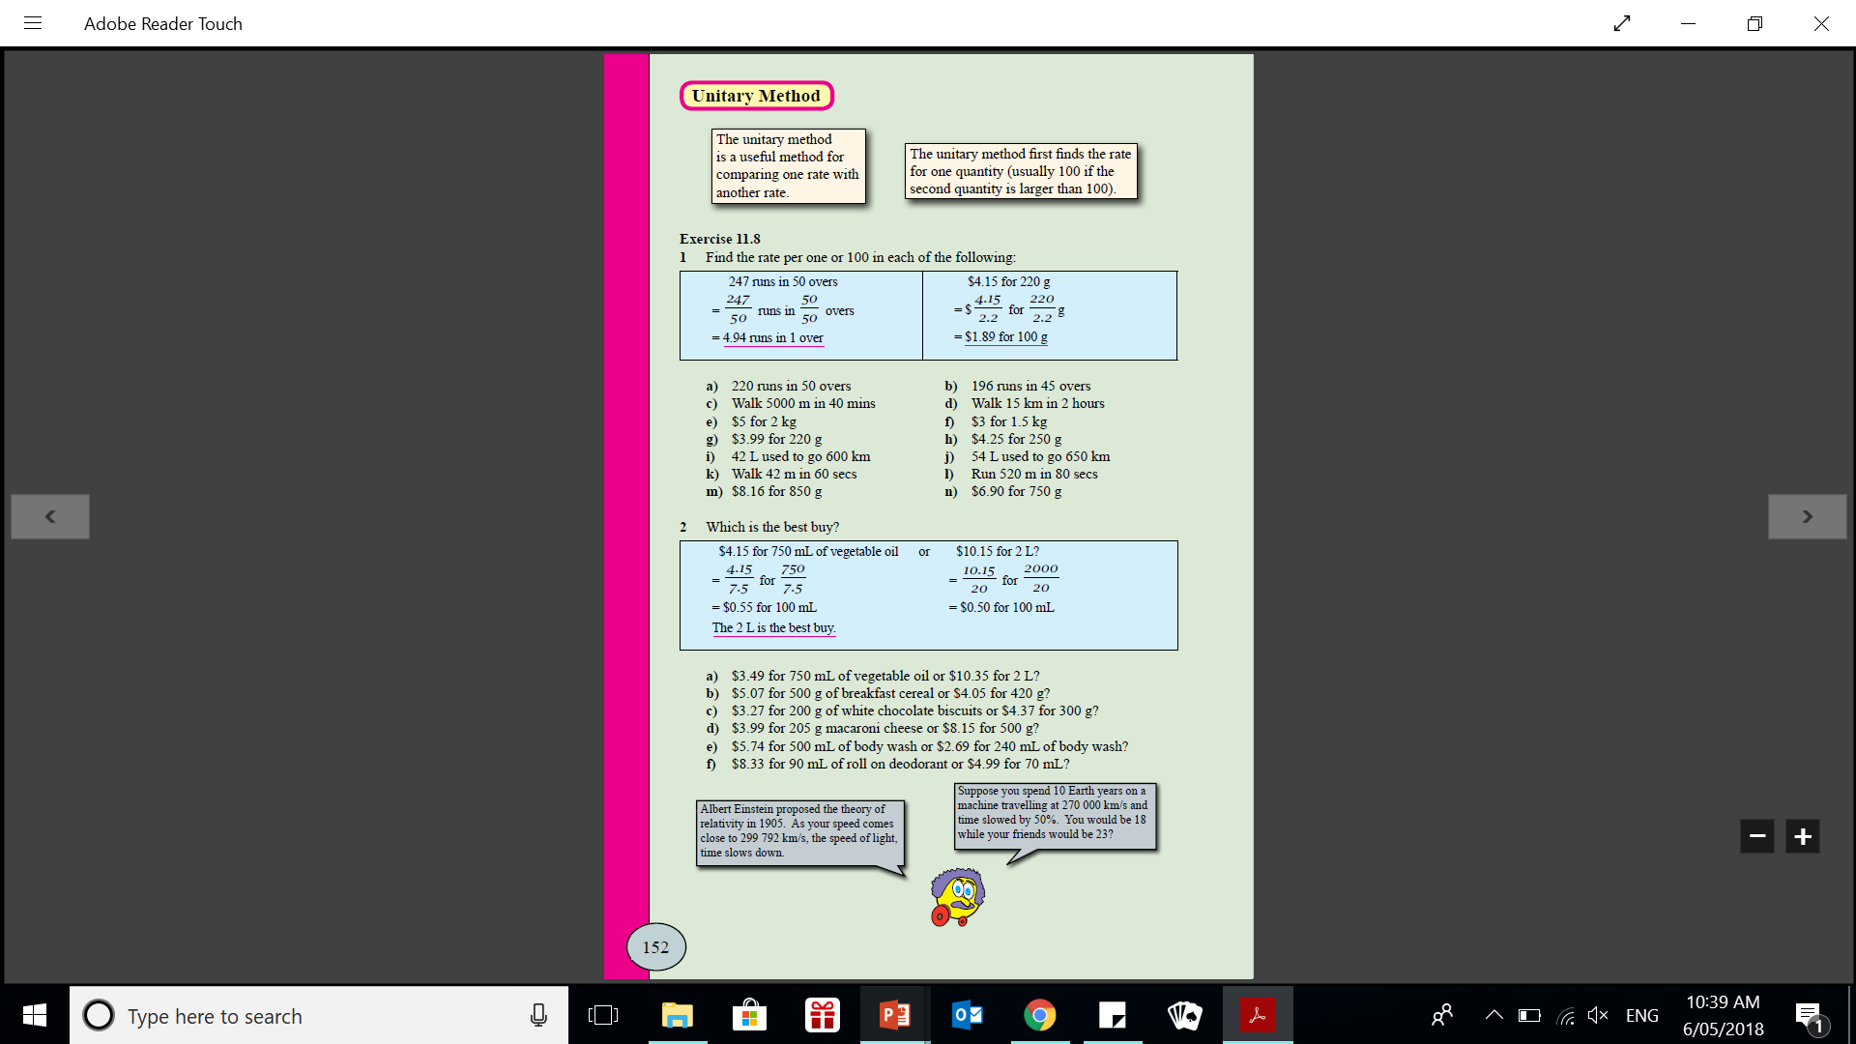
24
7
30
Date
Rates
EQ – What are the different methods for answering rates questions?
How do we find the rate?
To find the rate we need to work out what one of that unit will be.
To do this we need to divide both numbers by the same number

Slide 4
Practice questions (together)
$18.75 for 750g (how much /100g)
Run 750m in 80 secs (how far /sec)
Used 55L in 550 km (/100km)

Slide 5
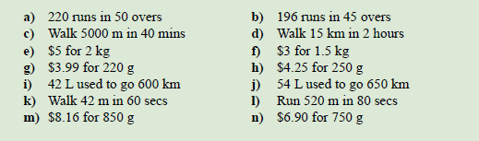
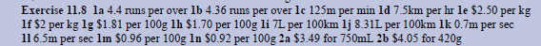

Slide 6


